Slide 1
Node JS – Express

Slide 2
Inhoud
Node JS
Express
Routing – Middleware
Headers – Cookies – Sessions
REST

Slide 3

Node JS
Open source
platformonafhankelijke runtime-omgeving
Gebruikt de JavaScript uitvoeringsengine (Zelfde als Chrome)
Ideaal voor real-time toepassingen
Zelfde ecosysteem als front-end
Info: https://kinsta.com/nl/kennisbank/wat-is-node-js/

Slide 4
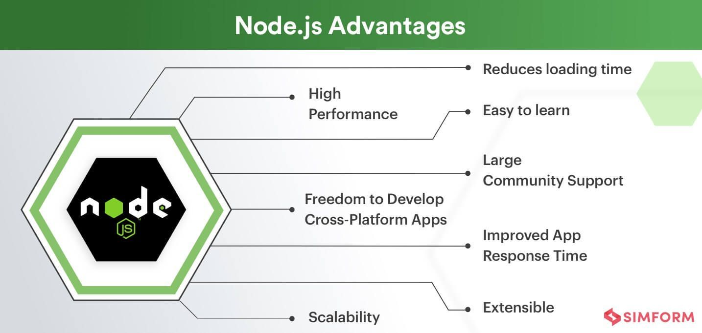
Voordelen Node JS

Slide 5
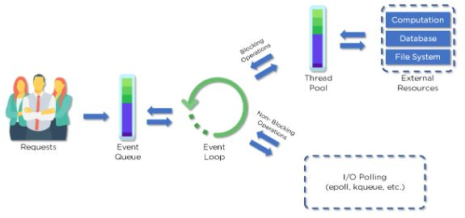
Node JS
Info: https://www.simplilearn.com/understanding-node-js-architecture-article

Slide 6
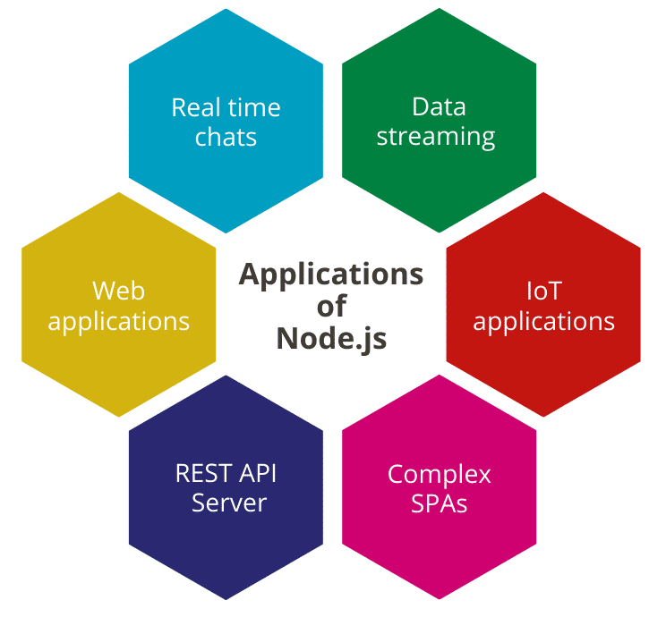
Toepassingen Node JS
SPA
API
IoT
Chat
Web Apps
Streaming
…

Slide 7
Express

Slide 8
Express
Open source framework
Standaard (web) server framework (voor Node)
Gebruikt Connect & HTTP
Sinds V4 enkel HTTP
Express.js
Connect
HTTP
Node.JS

Slide 9
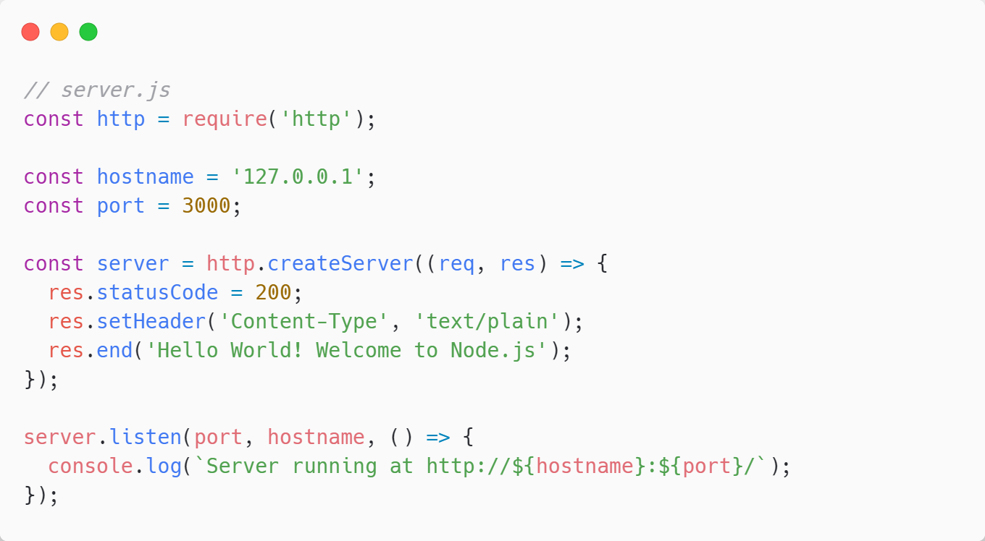
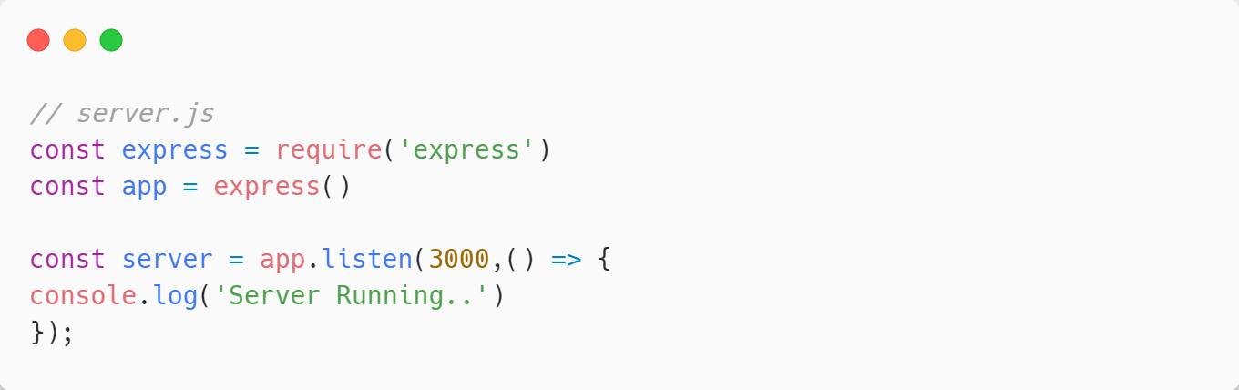
Node VS Express

Slide 10
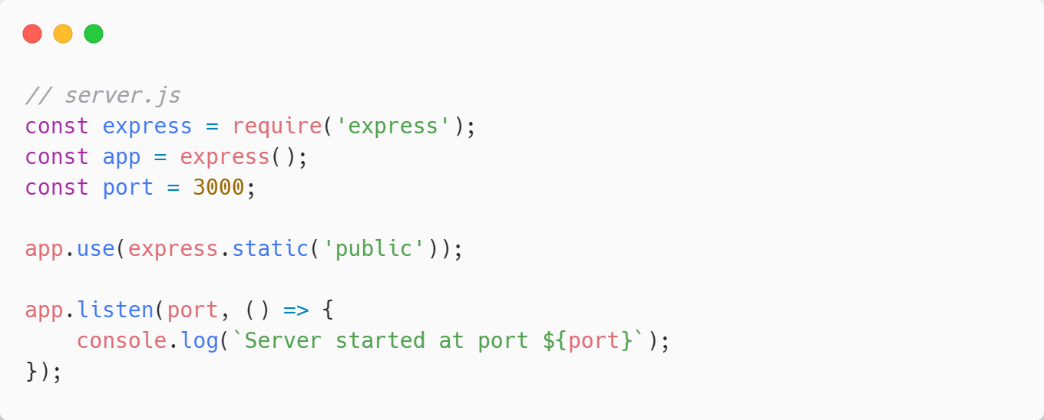
Static pages
Info: https://www.tutorialspoint.com/expressjs/expressjs_static_files.htm

Slide 11
Routing – Middleware

Slide 12
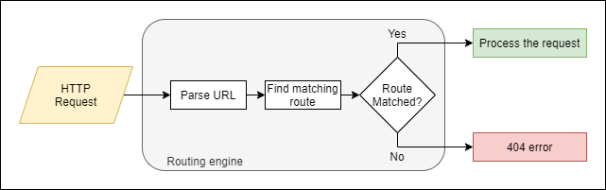
Routing

Slide 13
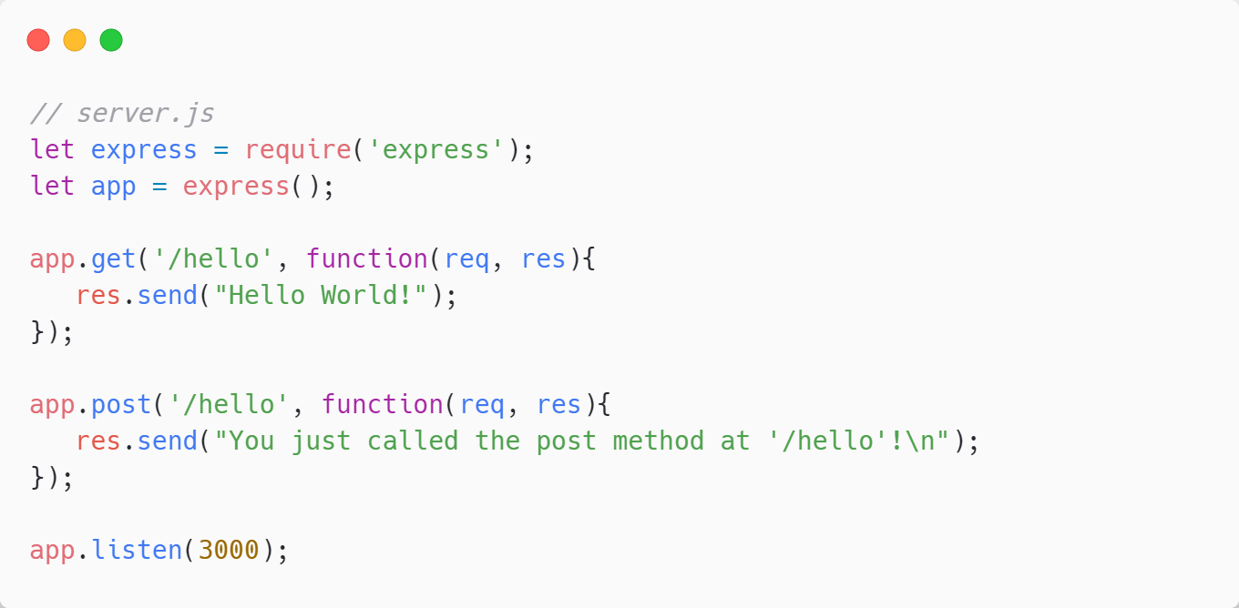
Routing in Express
Info: https://www.tutorialspoint.com/expressjs/expressjs_routing.htm

Slide 14
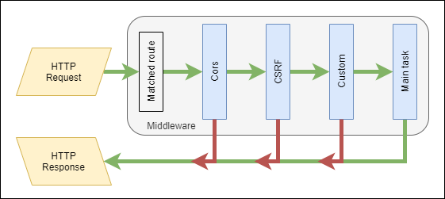
Middleware
Info: https://www.tutorialspoint.com/expressjs/expressjs_middleware.htm

Slide 15
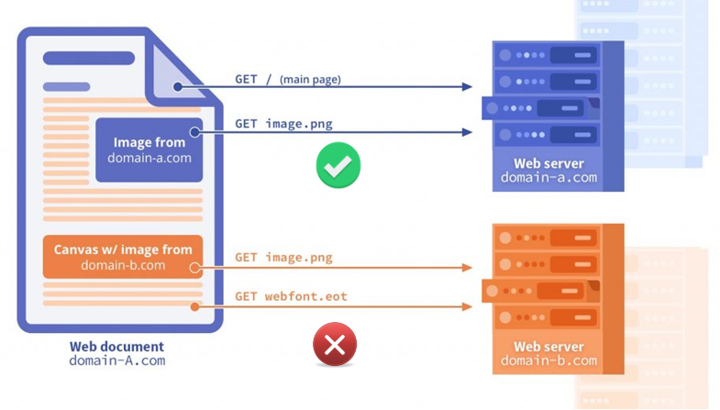
CORS (Cross-Origin Resource Sharing)
https://www.youtube.com/watch?v=4KHiSt0oLJ0

Slide 16
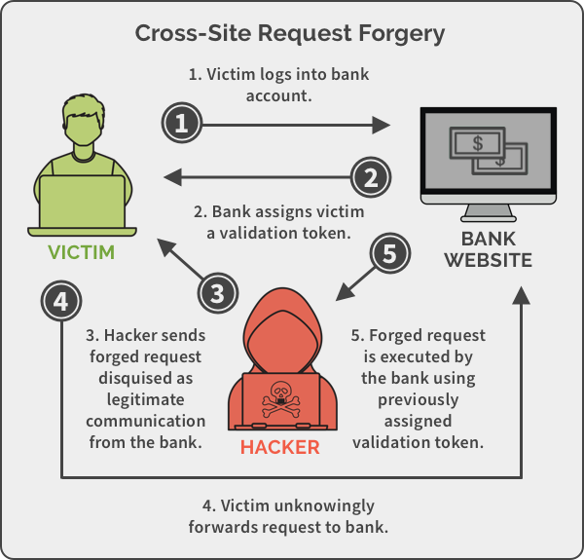
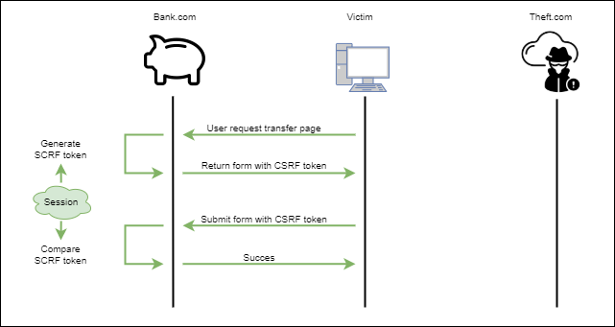
CSRF (Cross-Site Request Forgery)

Slide 17
Headers – Cookies – sessions

Slide 18
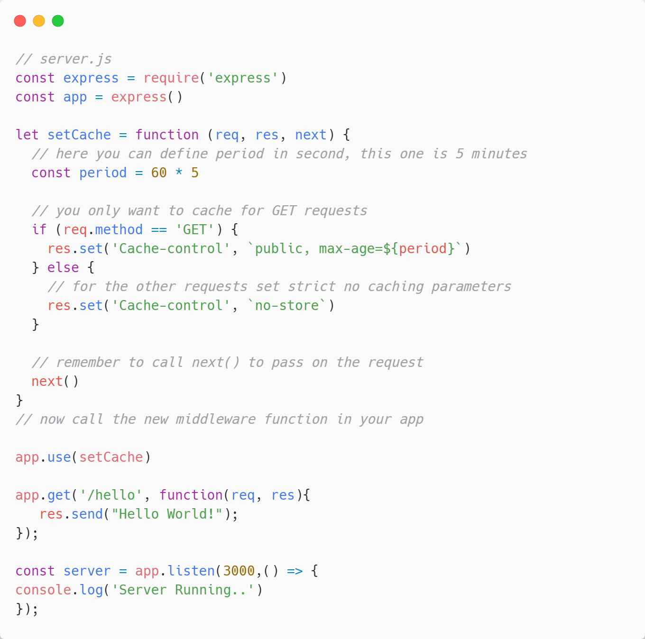
Headers
Info: https://regbrain.com/article/cache-headers-express-js

Slide 19
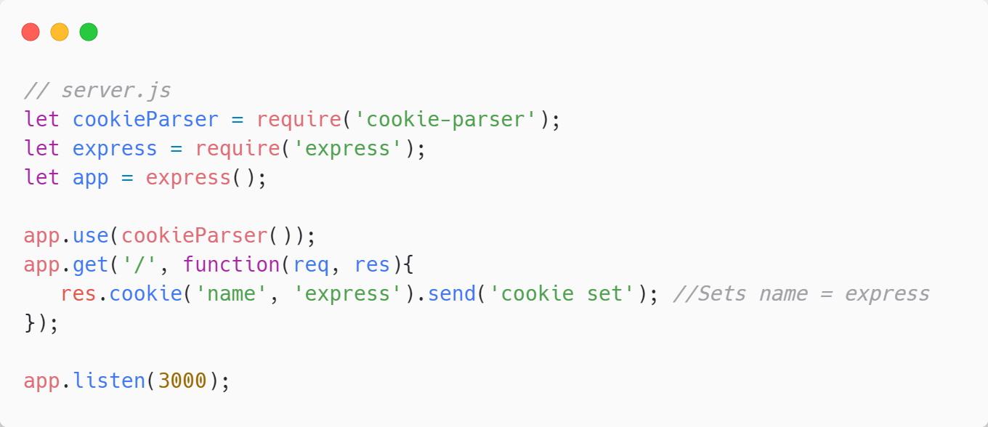
Cookies
Data opgeslagen op pc (klein tekst bestandje)
Info: https://www.tutorialspoint.com/expressjs/expressjs_cookies.htm

Slide 20
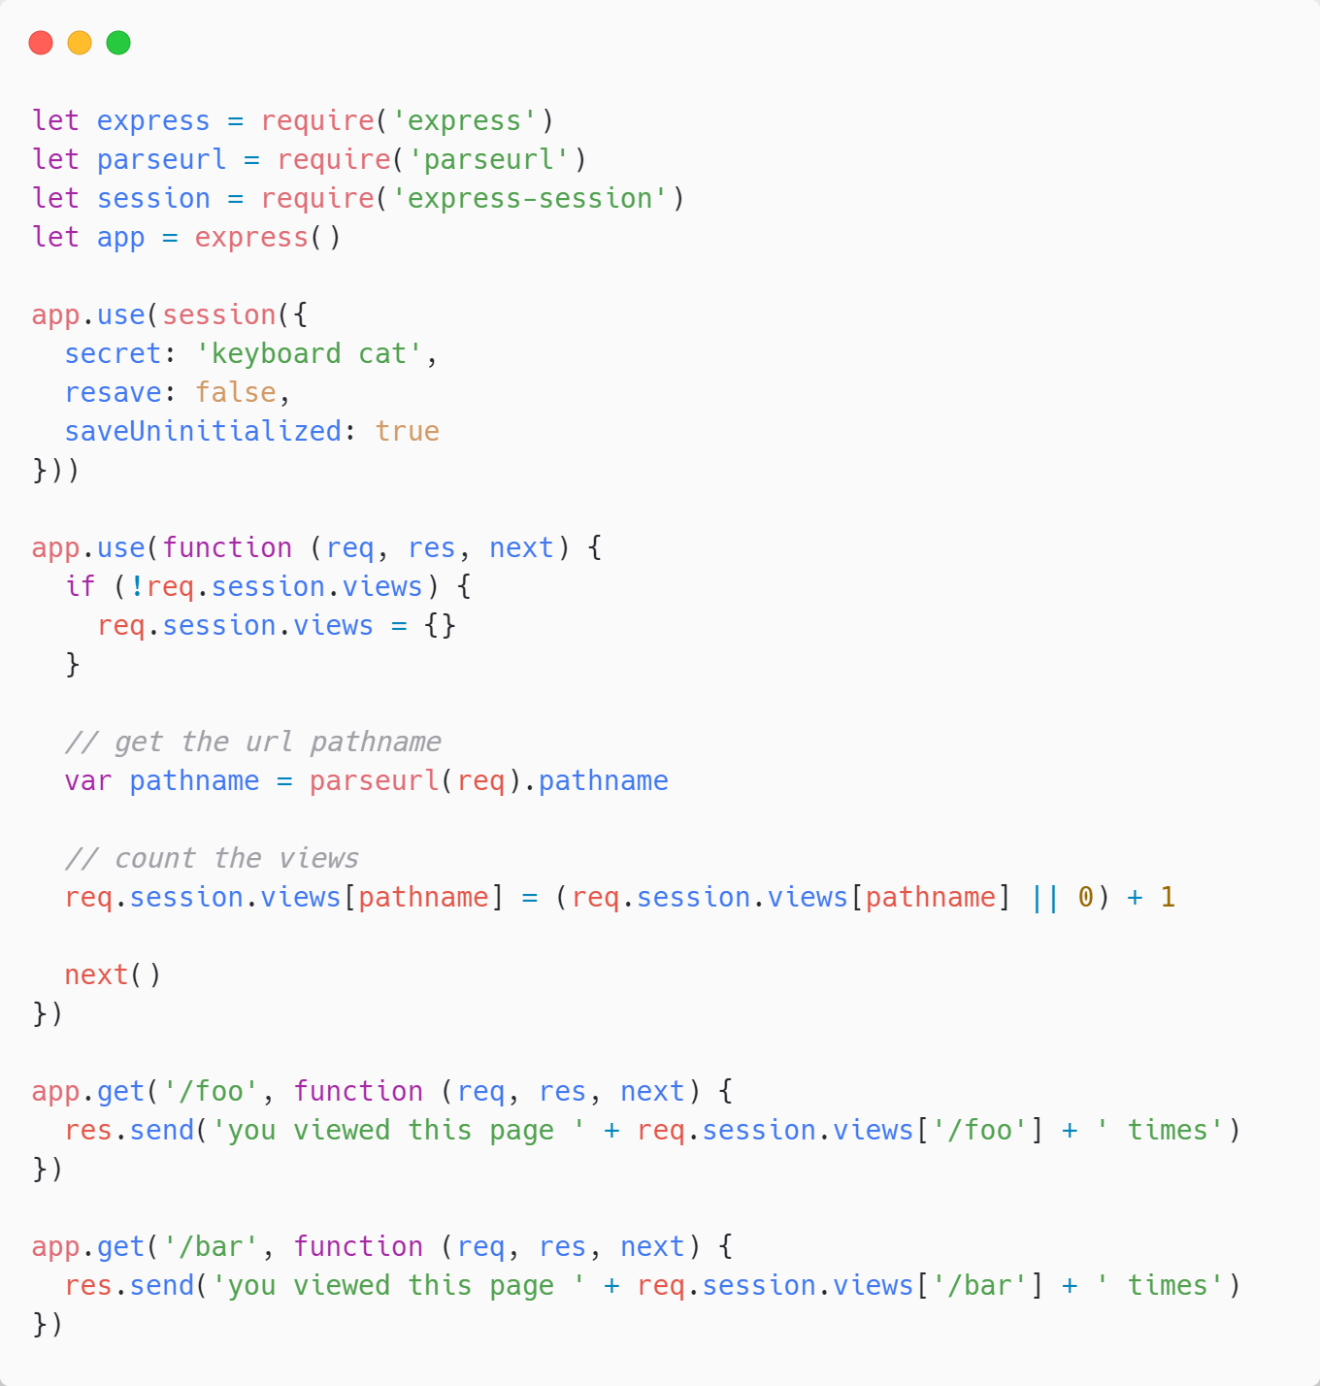
Sessions
Tijdelijke cookie
Identificatie via sessionID
Info: http://expressjs.com/en/resources/middleware/session.html https://www.tutorialspoint.com/expressjs/expressjs_sessions.htm

Slide 21
REST

Slide 22
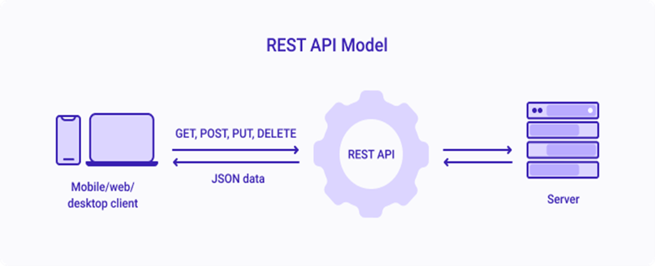
REST API (Representational state transfer)
Representational state transfer
Aplication programming interface
https://www.youtube.com/watch?v=-MTSQjw5DrM

